Slide 1
A SOFTWARE SUBSYSTEM OF LEARNING MANAGEMENT SYSTEMS
By: Tooba Hashmi, Hilario Lawrence, Puspa
Giri, William Smithson, Long Tong

Slide 2
GITHUB ( repository)
https://github.com/Thashmi23/Software2Rep

Slide 3
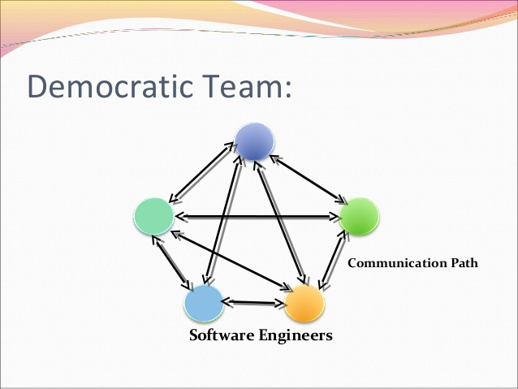
DEMOCRATIC TEAM APPROACH
Egoless programming is the basic concept
The team develops a group identity
The product belongs to all the group members
Decisions are made in a democratic fashion
Finding faults is a group effort

Slide 4
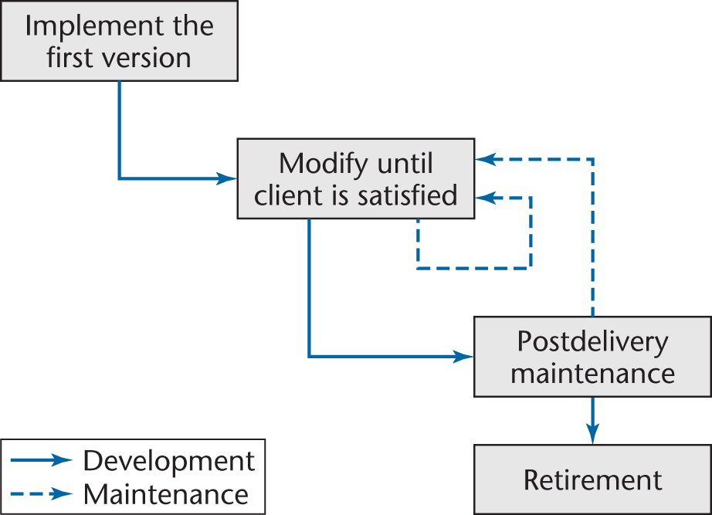
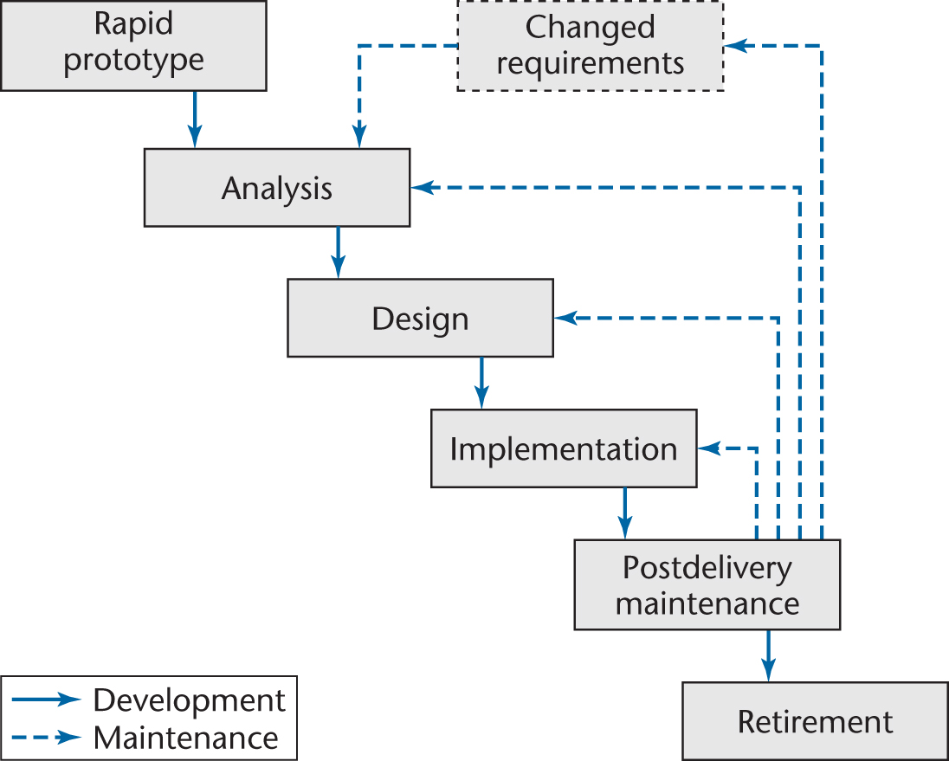
CODE AND FIX AND RAPID PROTOTYPE HYBRID

Slide 5
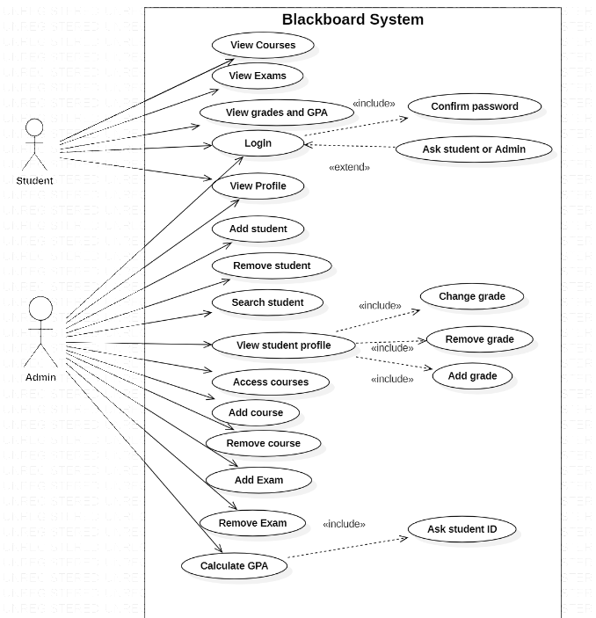
DIAGRAMS
USE CASES

Slide 6
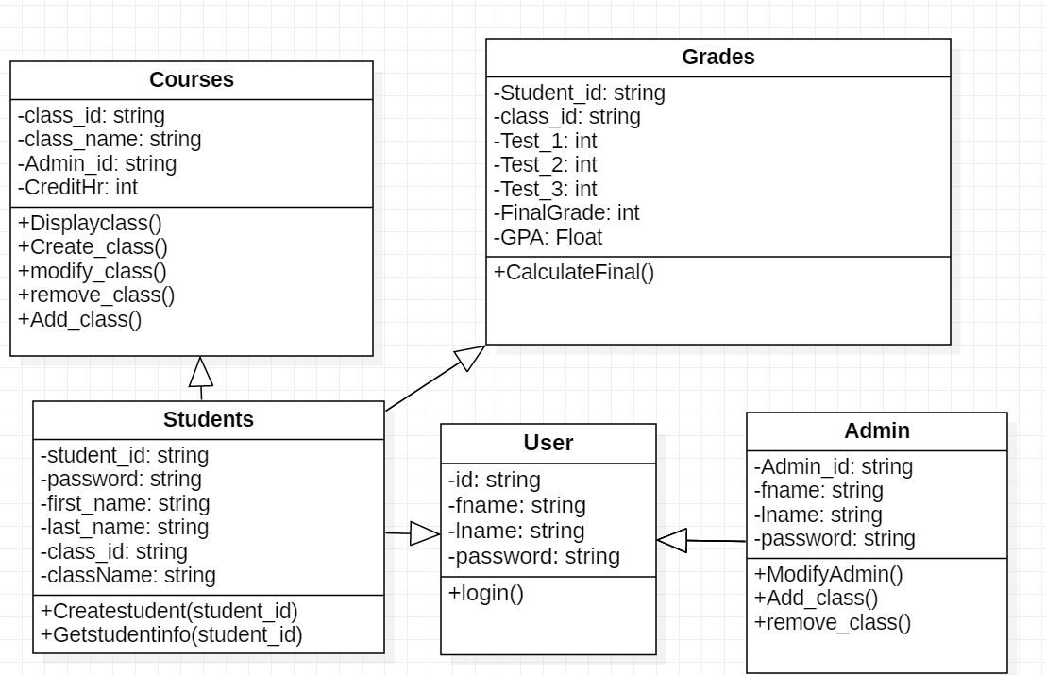
CLASS Diagram

Slide 7
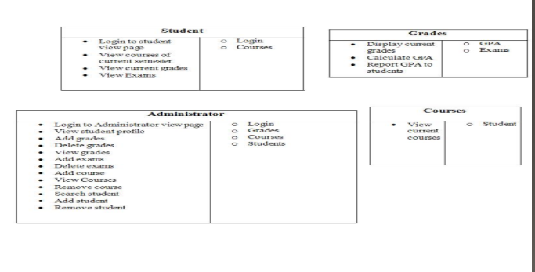
CRC CARDS

Slide 8
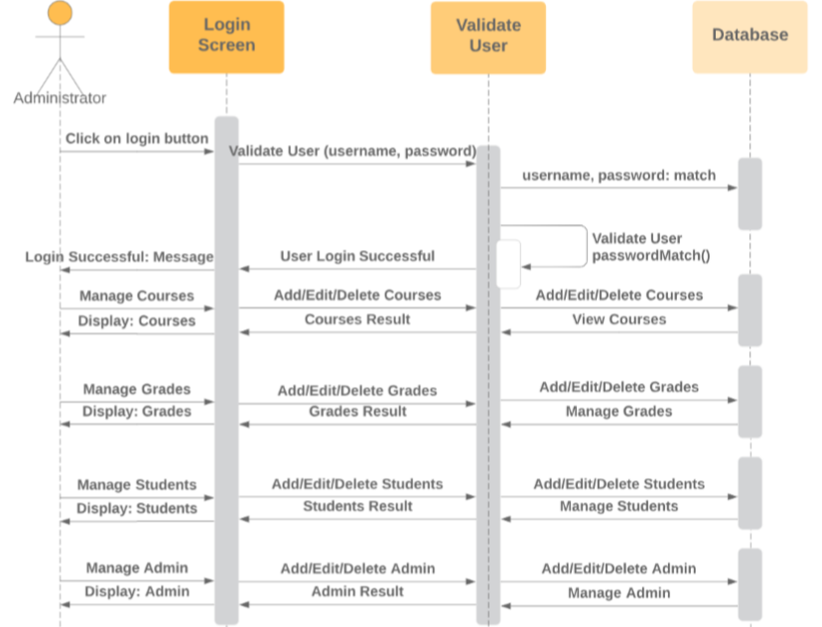
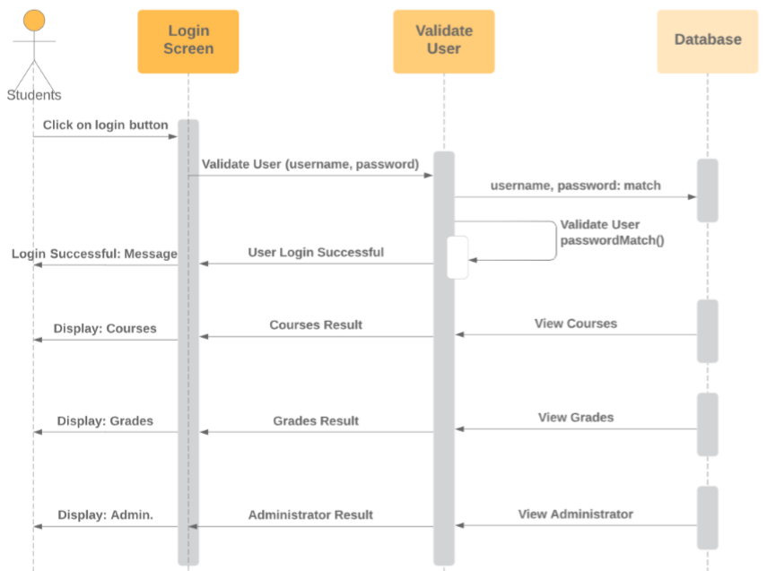
SEQUENCE DIAGRAMS
Admin Sequence Diagram
Student Sequence Diagram

Slide 9
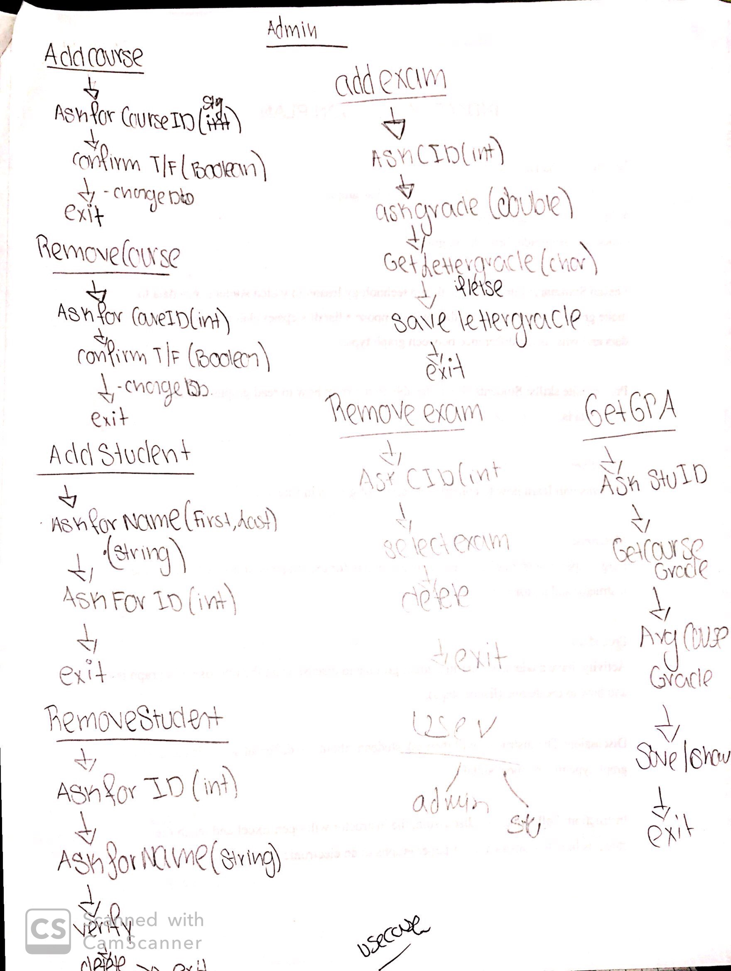
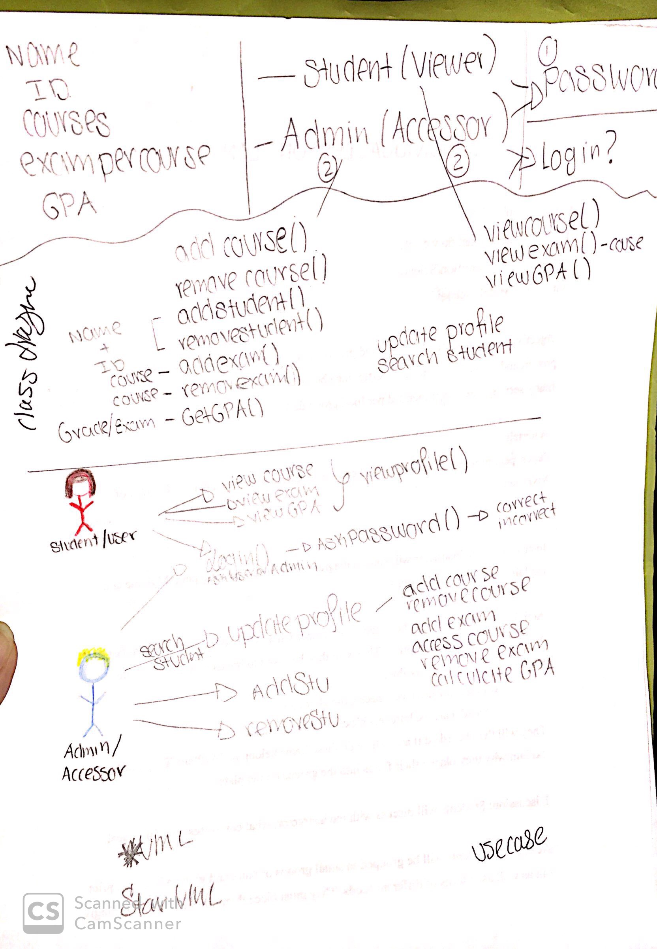
UML DIAGRAMS

Slide 10
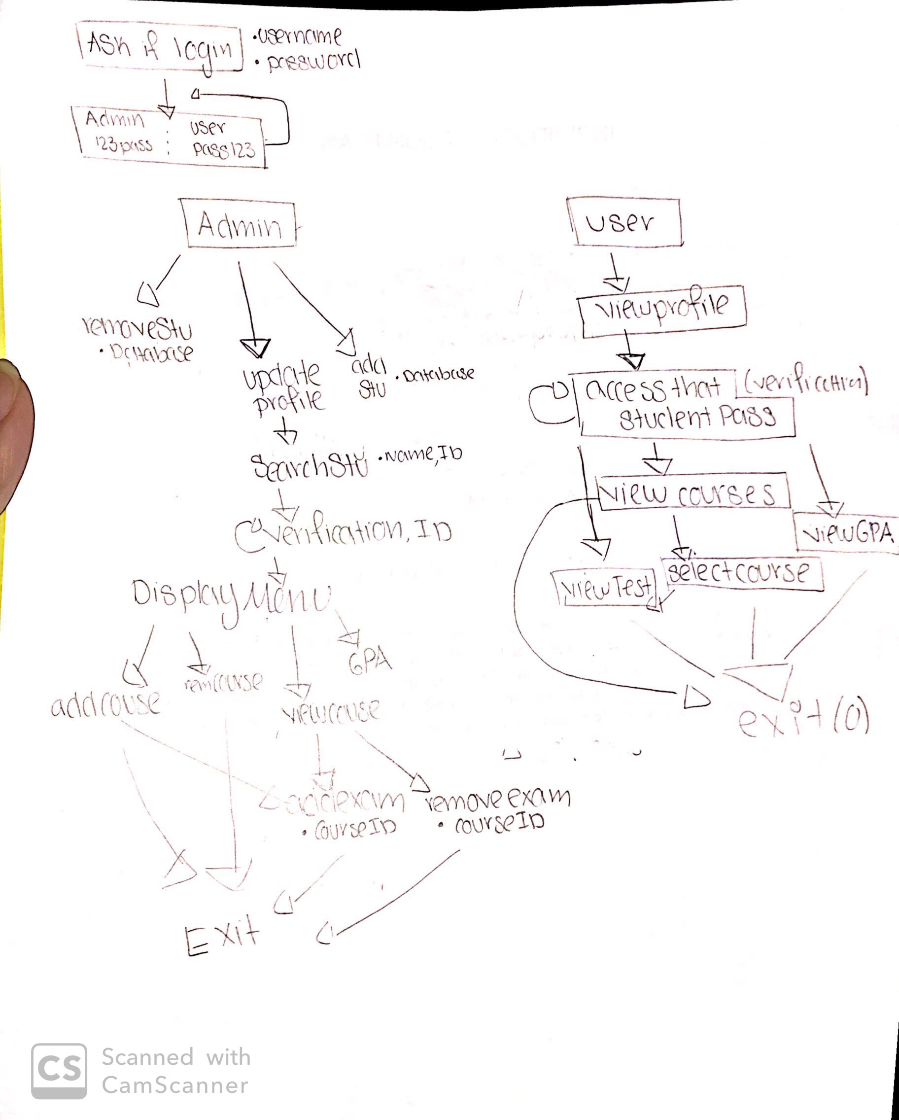
UML DIAGRAMS

Slide 11
TEST CASES/TESTING
Unit Testing
Integration Testing
System Testing

Slide 12
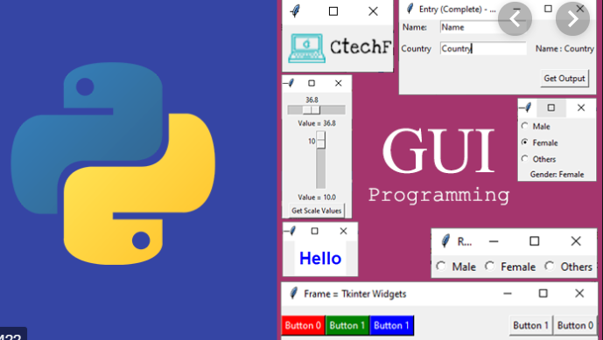
DEMO

